Slide 1
PHYSICAL CLOCK SYNCHRONIZATION
Done by :
K.B.N.Iswarya
161fa04306
Sec-E

Slide 2
SYNCHRONIZATION
Synchronization is coordination with respect to time, and refers to the ordering of events and execution of instructions in time.
For example, Ordering distributed events and ensuring that a process performs an action at a particular time.

Slide 3
Time and Clocks
It is often important to know when events occurred and in what order they occurred.
In a centralized system dealing with time is trivial as there is a single shared clock, where all processes see the same time.
In a distributed system, each computer has its own clock.
Because no clock is perfect each of these clocks has its own skew which causes clocks on different computers to drift and eventually become out of synchronization.

Slide 4
Clocks
Computer Clocks:
Oscillates at known frequency.
Clock skew:
The computer clocks on different processors of the distributed systems show different time.
Clock drift:
The computer clocks differ from real time
Time stamps:
Used to denote at which time an event occurred.

Slide 5
The difference in time between two clocks due to drifting is defined as clock skew. As long as any and every two clocks differ by a value less than the maximum skew value, the time service is considered to be maintaining synchronization.

Slide 6
Physical clocks
Every computer contains a clock which is an electronic device that counts the oscillations in a crystal at a particular frequency.
Synchronization of these physical clocks to some known high degree of accuracy is needed.
This helps to measure the time relative to each local clock to determine order between events.

Slide 7
Examples:
Performing events at an exact time(turn lights on/off,lock/unlock gates)
Sorting of events(for security,for profiling)
Tracking(tracking a moving object with separate cameras)

Slide 8
Physical clocks
There are two aspects:
Obtaining an accurate value for physical time
Synchronizing the concept of physical time throughout the distributed system
These can be implemented using centralized algorithms or distributed algorithms.

Slide 9
Obtaining an Accurate Physical Time
A physical time server is needed to access the current time from a universal time coordinator (UTC).
Two sources for UTC:
WWV shortwave radio station in Ft. Collins, Colorado
Geostationary Operational Environmental Satellites (GEOS)

Slide 10
If one machine has a WWV receiver, the goal becomes keeping all the other machines synchronized to it.
If no machines have WWV receivers, each machine keeps track of its own time; the goal is to keep the machines synchronized.

Slide 11
Physical Clock sychronization
Problem: Suppose we have a distributed system with a UTC receiver somewhere in it we still have to distribute its time to each machine.
UTC is Universal Coordinated Time, based on some atomic element (Cs)

Slide 12
Cont…
Basic principle:
Every machine has a timer that generates an interrupt H times per second.
There is a clock in machine p that ticks on each timer interrupt. Denote the value of that clock by Cp{t}, where t is UTC time.
Ideally, we have that for each machine p,
Cp{t} = t, or, in other words, dC/dt =1

Slide 13
Cont..
dC/dt denotes the ratio of the change in the clock time to actual time.
In “perfect world” dC/dt should be one

Slide 14
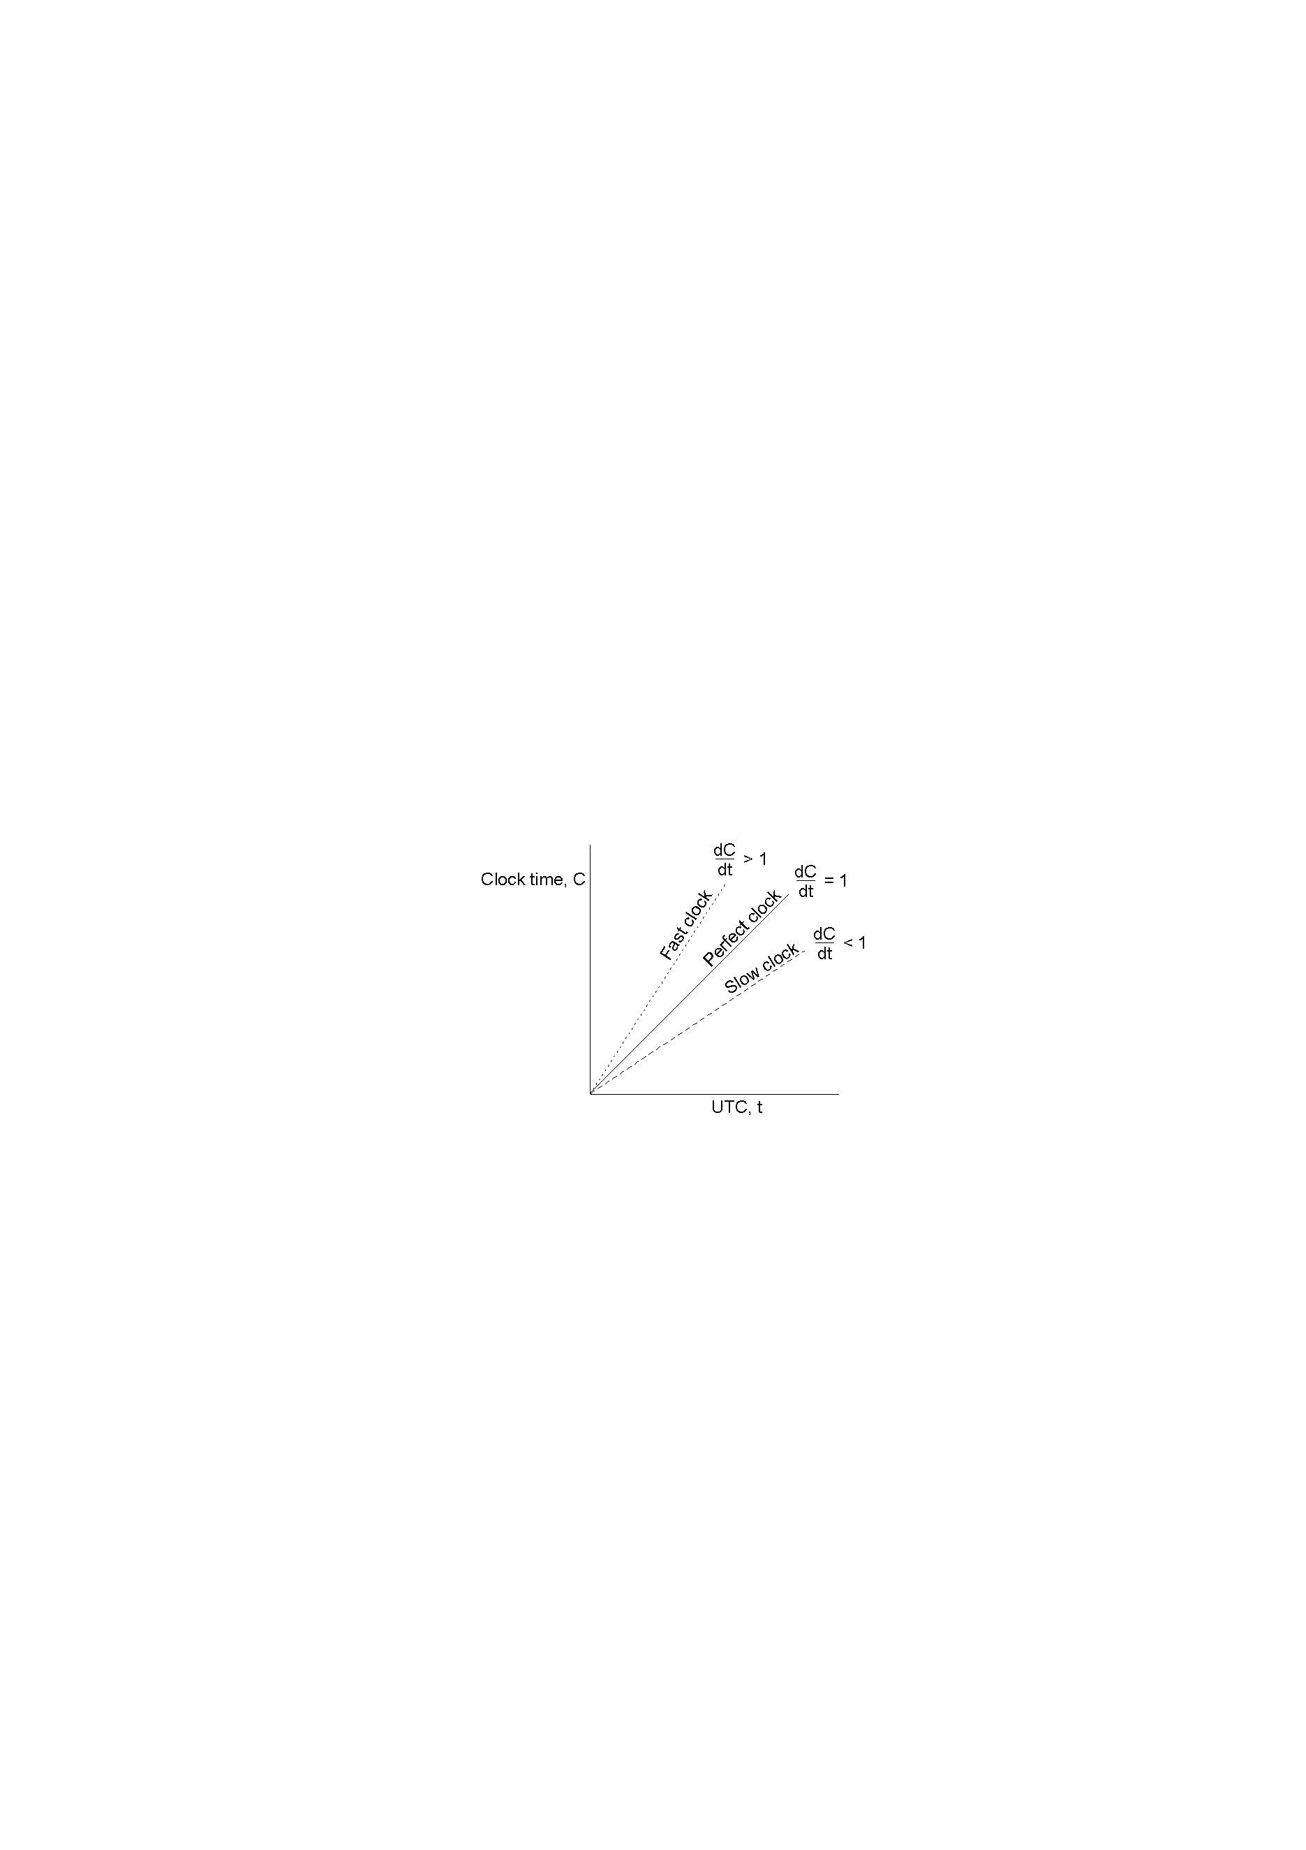
Cont..
The relation between clock time and UTC when clocks tick at different rates.

Slide 15
Cont..
Each clock has a maximum drift rate ρ.
1-ρ <= dC/dt <= 1+ρ
In time Δt a clock may drift ρΔt
Assume two clocks are synchronized at time t.
Assume that the clocks drift the maximum possible in Δt in opposite directions. In Δt, they are2ρΔt apart.
To limit drift to σ
2ρΔt=σ
Δt=σ /(2ρ).
resynchronize every δ/2ρ seconds

Slide 16
Physical Clock Sychronization Algorithms
Physical clock synchronization algorithms can be classified as :
Distributed clock synchronization Algorithms
Centralized clock synchronization Algorithms

Slide 17
Distributed clock synchronization Algorithms
There is no particular time server.
The processors periodically reach an agreement on the clock value by averaging the time of neighbours clocks and its local clock.
This can be used if no UTC receiver exists(no external synchronization is needed).
Only internal synchronization is performed.
Processes can run on different machines and no global clock to judge which event happens first.

Slide 18
Centralized clock synchronization Algorithms
These have one node with a real-time receiver and are called time server node. The clock time of this node is regarded as correct and used as reference time.
The goal of this algorithm is to keep the clocks of all other nodes synchronized with time server node.

Slide 19
Cristian’s Algorithm
Cristian’s Algorithm is a centralized algorithm.
The simplest algorithm for setting time,it issues a Remote Procedure call to time server and obtain the time.
A machine sends a request to time server in d/2 sec, where d=max diff between a clock and UTC.
The time server sends a reply with current UTC when receives the request.

Slide 20
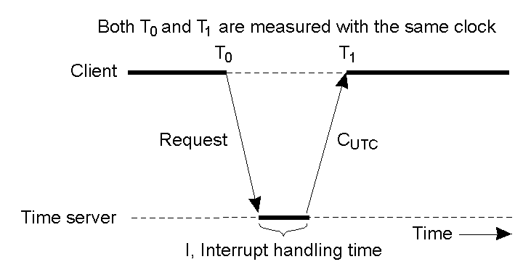
The machine measures the time delay between time server sending the message and machine receiving it.
Then it uses the measure to adjust the clock.

Slide 21
The best estimate of message propagation time=(T1-T0)/2
The new time can be set to the time returned by server plus time that elapsed since server generated the timestamp:
Tnew=Tserver+(T1-T0)/2
Assume the clock time of client be To when it sends the message and T1 when it receives the message from server.
When the time server receives the message it responds with a message T, where T is the current time of server node.

Slide 22
For this several measurements of T1-To are made and if these measurements exceed some threshold value then they are unreliable and discarded.
The average of the remaining measurements is calculated and the minimum value is considered accurate and half of the calculated value is added to T.

Slide 23
Advantage-It assumes that no additional information is available.
Disadvantage- It restricts the number of measurements for estimating the value.

Slide 24
Berkeley Algorithm
Suitable when no machine has a WWV receiver.
The time server (daemon) is active:
Time daemon polls every machine periodically to ask what time is there
Based on the answers, it computes an average time
Tells all other machines to advance their clocks to the new time or slow their clocks down until some specified reduction has been achieved.
Propagation is taken into account.
The time daemon’s time is set manually by operator periodically.

Slide 25
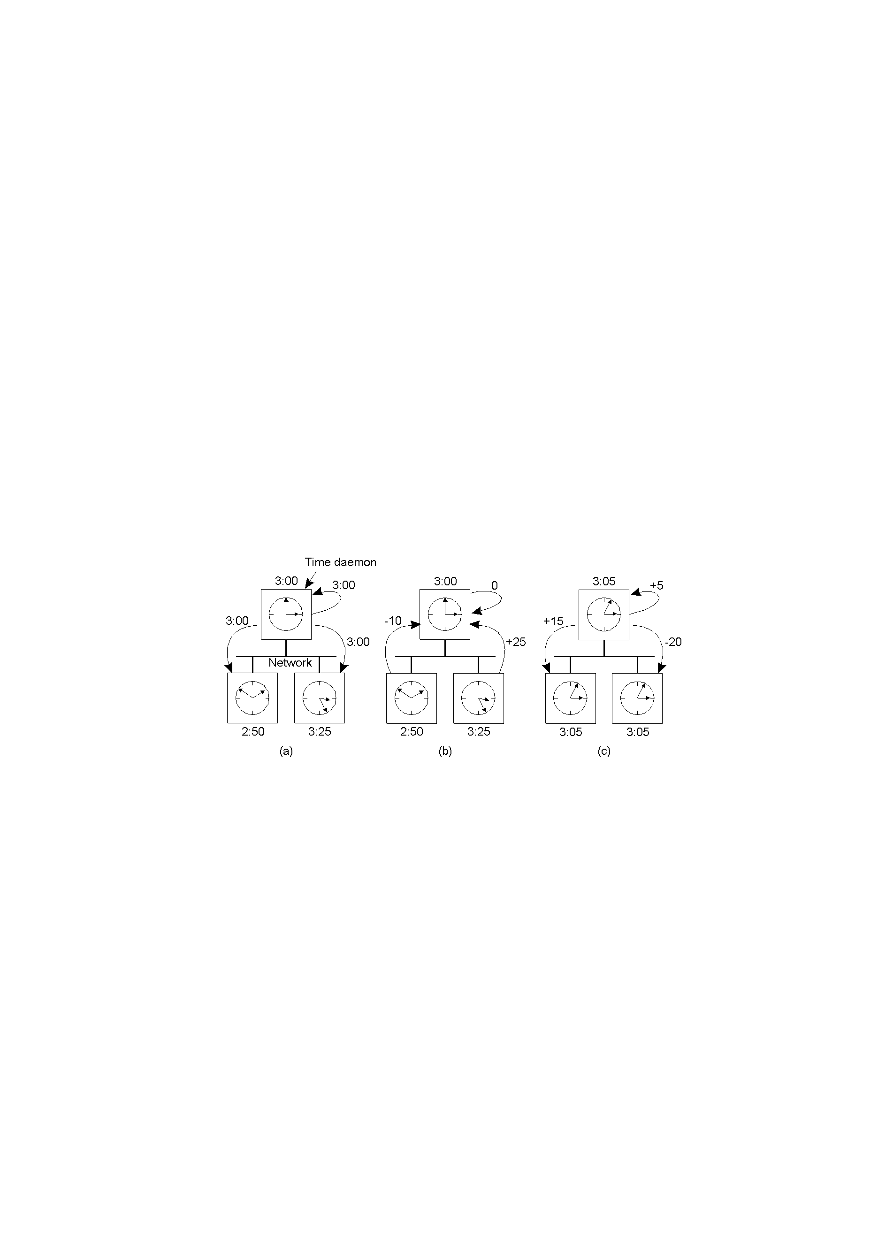

Slide 26
The time daemon asks all the other machines for their clock values using a polling mechanism and providing “current time”
The machines answer indicating how they differ from time sent.
The time daemon tells everyone how to adjust their clock based on a calculation of the “average time value”.

Slide 27
Network Time Protocol
Christian’s method and Berkeley algorithm intended for intranets
NTP intended to provide the ability to externally synchronize clients across the Internet to UTC.

Slide 28
The NTP service is provided by a network of servers located across the Internet.
Primary servers receive UTC.
Secondary servers are synchronized with primary servers.
The servers are connected in a logical hierarchy called a synchronization subnet whose levels are called strata.

Slide 29
An example synchronization subnet in an NTP implementation
1
2
2
3
3
3
Note: Arrows denote synchronization control, numbers denote strata.

Slide 30
Layered client-server architecture, based on UDP message passing.
The clocks belonging to servers with high stratum numbers are liable to be less accurate than those with low stratum numbers since errors are introduced at each level of synchronization.
If a strata 1 server fails, it may become a strata 2 server that is being synchronized through another strata 1 server.
Accuracy: range of 1-50 msec

Slide 31
A 1999 survey of NTP servers shows the following:
175,000 servers running NTP in the Internet
300 are stratum 1 servers
Over 20,000 are stratum 2 servers
Over 80,000 are stratum 3 servers

Slide 32


